Slide 1


Allstate - Predicting Insurance Claim Losses
Project team: Sarita, Philipp, Waseem Date: August 29, 2025

Slide 2
Goal: Predicting Claims Severity
Better prediction → Improved pricing, reserves, and risk management
Technical Objective → To create a robust machine learning model that predicts the claim loss based on the provided features.

Slide 3
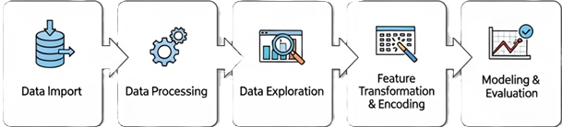
The Data
Target variable → Claim Loss ($).
188k rows and 130 features (14 numerical + 116 categorial)
No missing values

Slide 4
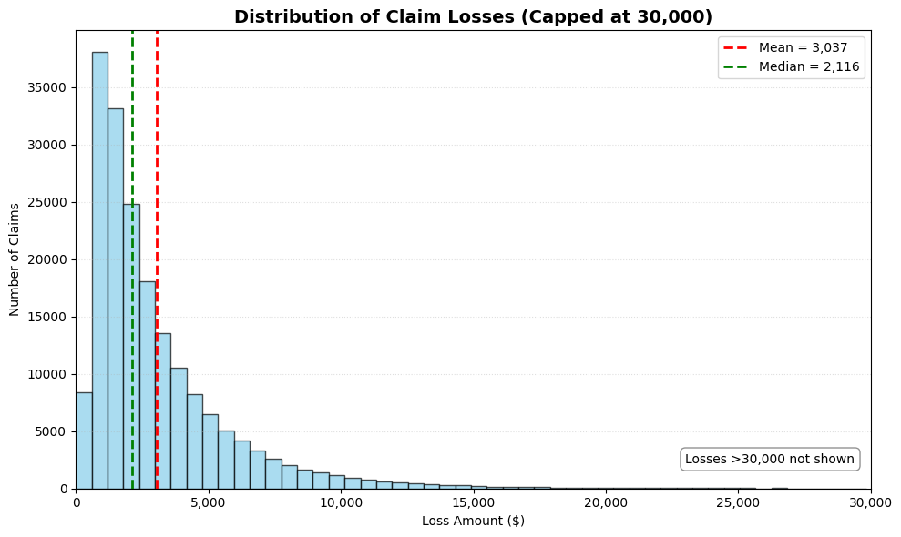
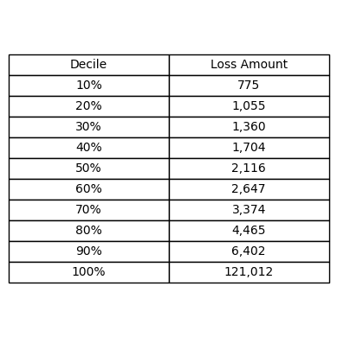
Exploration of Claim Losses

Slide 5
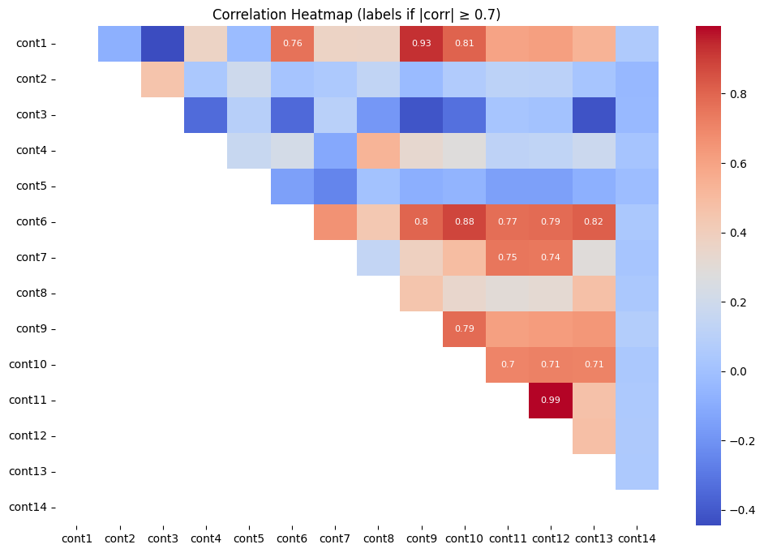
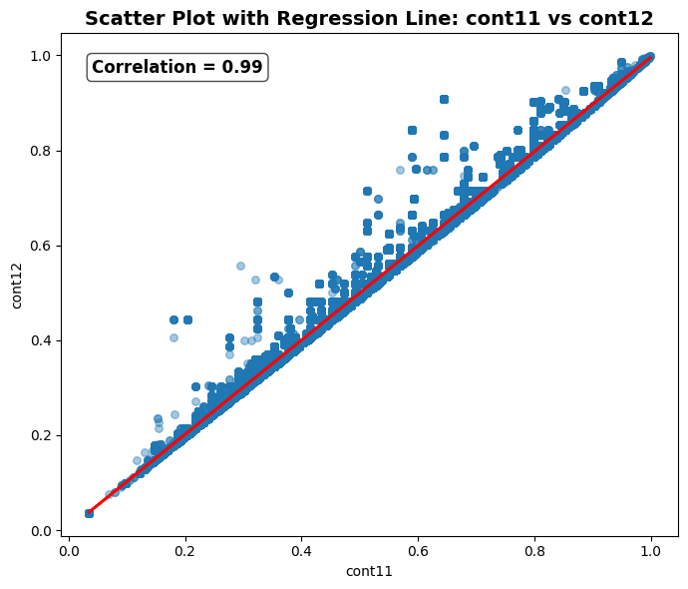
Correlations

Slide 6
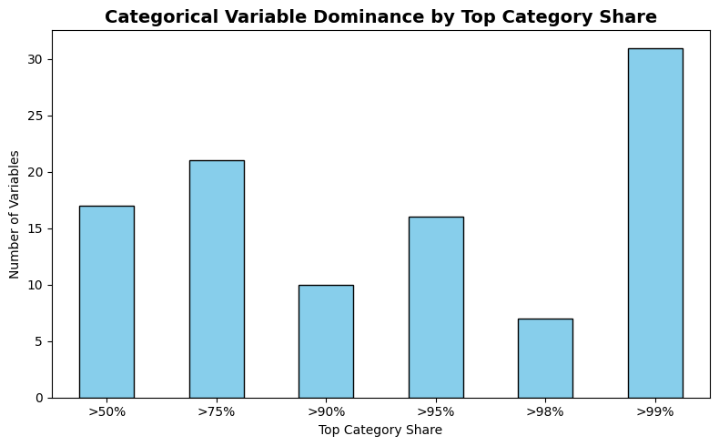
Categorial Dominance
Almost zero variation for many categorial features

Slide 7
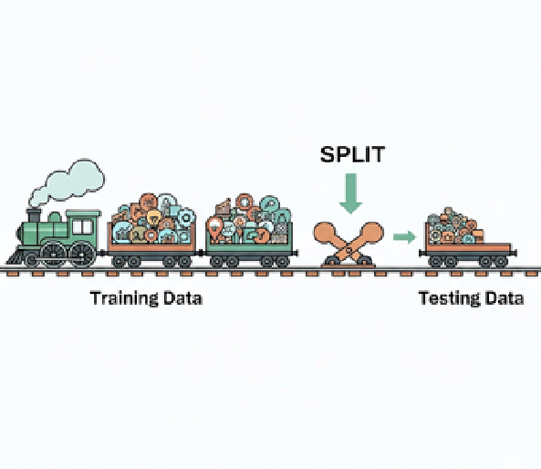
Data preparation
Train-Test-Split: 80% / 20%
Drop variable cont12, as it can be “perfectly” predicted by the other numerical variables → R^2 of 99% for cont12 regressed on these
Dropped 9 constant-like categorical features.
Compressed rare levels (<1%) to for 45 categorial features.
One hot encoding for remaining categorial features.

Slide 8
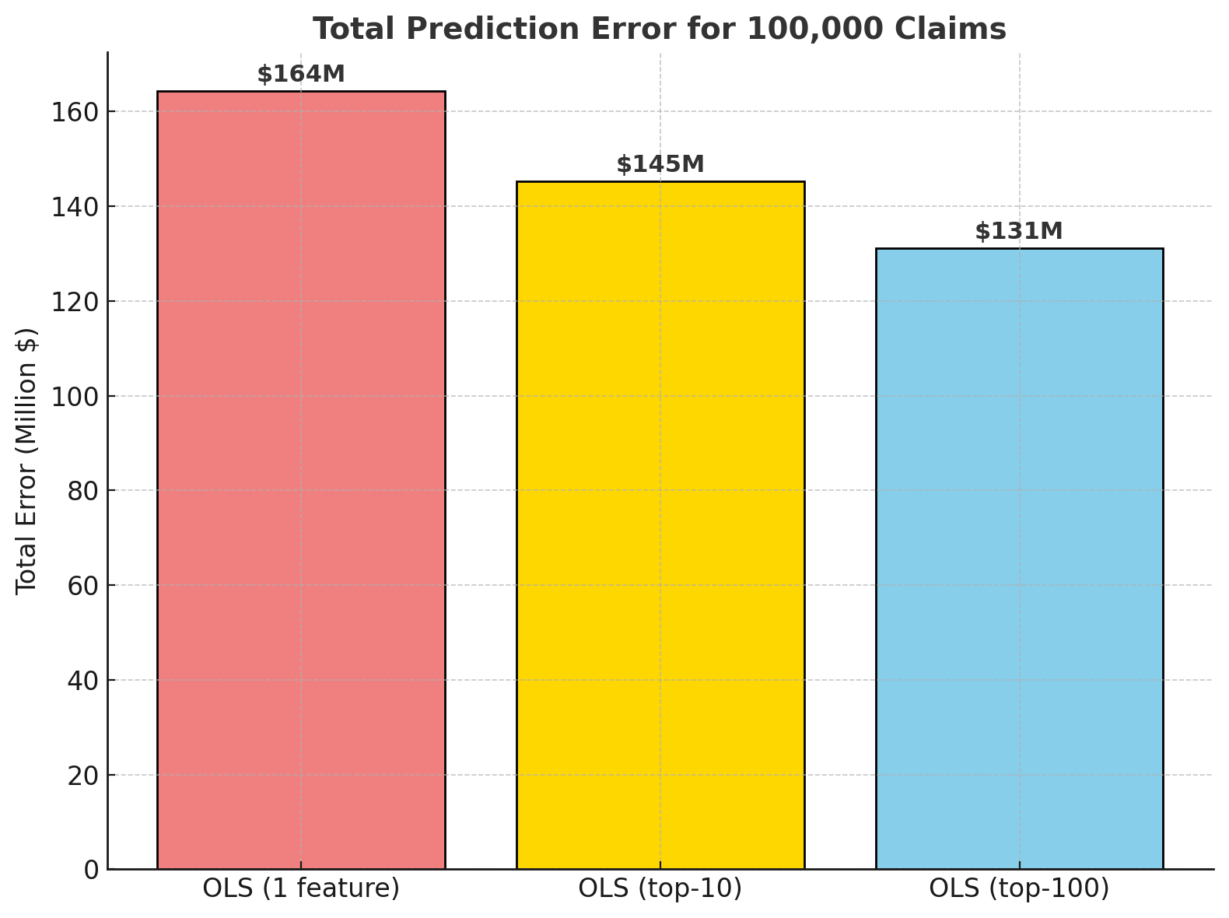
Baseline Models
OLS (only 1 feature)
Uses only strongest single predictor
R² = 0.22 | MAE ≈ $1,644
On average, predictions miss the true claim by
over 50% of the mean loss ($3,000)
OLS (top 10 features)
Adds 10 strongest predictors
R² = 0.37 | MAE ≈ $1,453
Error still 48% of the mean claim size
OLS (top 100 features)
Expands to 100 strongest predictors
R² = 0.49 | MAE ≈ $1,311
off by ~44% of the mean claim — a clear improvement, but still quite inaccurate

Slide 9
Advanced Model: XGBoost
What XGBoost Is (general idea)
Ensemble of many small decision trees (“boosting”)
Each new tree fixes mistakes from the previous ones
Captures non-linear patterns and feature interactions
Regularization prevents overfitting (built-in penalties)
What We Did (our model setup)
Trained on all encoded features, let model pick what matters
Optimized directly for MAE (average dollar error per claim)
Used validation split + early stopping to avoid overfitting
Ran a parameter search (depth, learning rate, regularization) to fine-tune performance
Notes:
At each split of each tree, the algorithm evaluates all available features and chooses the one that most improves the objective (in your case, reducing MAE).
Features that consistently create “good splits” get used often, sometimes at different thresholds or in interaction with others.
Features that provide no improvement simply don’t get chosen in splits — they effectively get ignored.
Over thousands of trees, the algorithm naturally prioritizes the informative features and leaves the weak ones unused or rarely used.
👉 That’s why you could feed in all encoded variables, and the model still concentrated predictive power on the ones that actually mattered.

Slide 10
XGBoost Results
Model setup (best configuration)
Grow policy: lossguide, max leaves = 31
Learning rate: 0.03
Regularization: α = 0.01, λ = 0.5
Best ieration: 4,150 trees
Performance (Validation / Test)
R² ≈ 0.57 / 0.56
MAE ≈ $1,139 / $1,136 per claim

Slide 11
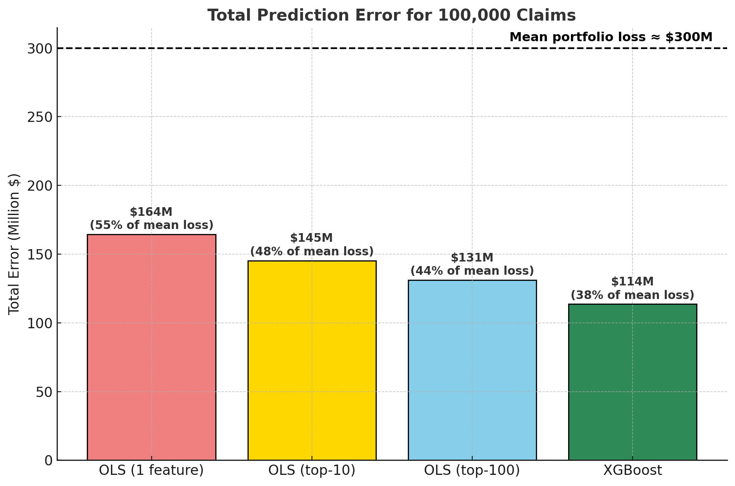
Takeaways
Average claim ≈ $3,000 → error ≈ 38% of mean claim
Scales to ~ $114M error across 100,000 claims
Strong improvement over baselines (~$131–164M error)

